Slide 1

ElectroStatic Detection Apparatus
ESDA
An instrument for the detection of indented writing documents
13th November 2019

Slide 2
Topics to be discussed
Indented Writing
Indentation Recovery Methods
ElectroStatic Detection Apparatus (ESDA)
  Basic Principles of ESDA and its components
  Fundamental of Electrostatics
  Variables Affecting the Results from ESDA
Example of Questioned Document
Appendix : Theoretical consideration

Slide 3
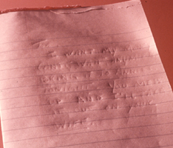
Indented Writing : The Origin
If a document is written while resting atop other papers, impressions of the writing will be transferred to the underlying sheets.
http://www.leelofland.com/wordpress/?p=4265
Notes:
Identification of Indented Writing
Indented writing is an imprint which may be left on the underlying pages when the top sheet of paper is written upon. This impression of the writing is influenced by pen pressure and thickness of the paper. Indented writing is very useful as a form of connecting evidence, such as tying a robbery note to a writing pad recovered from a suspect. Classically, indented writing was identified and deciphered by means of low angle oblique light and photography. More recently, an instrument known as an Electrostatic Detection Apparatus, or ESDA, is now used to produce a visual image of the indented writing on transparency film. This procedure is non-destructive, and rather non-detectable.

Slide 4
The Non-Destructive Indentation Development Methods
Indented writing is normally recovered by
  photographically using oblique-angle light, or
  using of an apparatus commonly referred to as ESDA, for ElectroStatic Detection Apparatus.

Slide 5
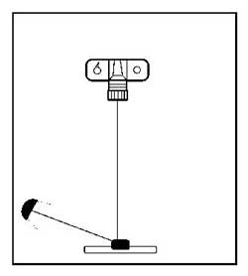
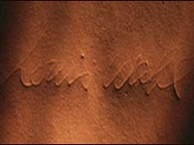
Oblique Lighting :light shone at a shallow angle
Oblique-angle lighting casts shadows into the depressions in the paper.
The record prints of the images are obtained by photographed.
The technique is time consuming and can recover only the deep impressions.
Light source
Questioned
document
http://www.staggspublishing.com/closeup.html
Notes:
Oblique light is applied to the surface of the paper to reveal any furrows of indented writing.
A photo is then taken of the shadowed indentation.
Moving the light source and taking multiple exposures should fill in most available indentations with shadow, and hopefully reproduce the indented writing.
While oblique lighting techniques are often quite accepted in court, they're unable to recover invisible microscopic indentations, which may occur three or four pages down.
Oblique lighting uses a light source at a low angle, usually to show detail by creating shadows in the subject surface

Slide 6
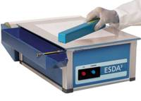
ElectroStatic Detection Apparatus
ESDA
A more sensitive technique based on the electrostatic principle was proposed by D J Foster and D K Morantz in 1978.
Weak latent writing impressions on the surface of a paper can be effectively detected and permanently recorded.
Notes:
Some documents are unsuited for this process -- documents previously processed for latent fingerprints, made of thick cardboard, or which have been saturated with fluids fall into this category.
The page suspected of bearing indentations is covered with a cellophane material which is then pulled into firm contact with the paper by a vacuum drawn through a porous bronze plate. This serves to "fasten" the document, and cellophane covering, to the plate. The cellophane covering prevents damage to the original document. The document and cellophane are then subjected to a repeated high voltage static charge.
This results in a variably charged surface, with the heavier static charge remaining within any impressions, even microscopic ones. Black toner (similar to that used in dry-process photocopy machines), is then cascaded over the cellophane surface. The areas of the document containing the higher static electric charge retain the black toner, resulting in a deposit of toner in the indentations in the paper. These developed indentations may be photographed and then preserved by means of placing an adhesive backed clear plastic sheet over the cellophane while it is still being held in place by the vacuum of the ESDA.
The advantages of electrostatic detection are two-fold: ESDA is extremely sensitive, and it's also non-destructive. The indentations are revealed on the protective cellophane surface, and the original document remains unharmed throughout the process.

Slide 7
ESDA: Projectina Docustat DS-210
Corona unit
Metal plate
Controls
Notes:
http://digital.lgcforensics.com/services/questioned-documents/electrostatic-detection-apparatus.html
Electrostatic detection apparatus
ESDA stands for Electrostatic Detection Apparatus. This instrument is used to produce a permanent 'lift' from paper which provides a visual map of indented impressions in that paper. (See also indented impressions above) ESDA has the advantage of being non-destructive so that the paper under examination remains in exactly the same state, and is still available for other examinations. It is also extremely sensitive meaning that indentations found up to seven sheets below the page where the original writing was made may be visualised.
ESDA works by stretching a Mylar film (like Clingfilm) over the document being examined. This Mylar film is then electrostatically charged using a 'wand' containing a fine wire charged to 7KV. Where the paper is smooth the charging is generally uniform, however where the fibres of the paper have been disturbed by paper-paper contact caused by indentations, the electrostatic charge is different to the background. This creates a latent image. In order to visualise this latent image, black toner similar to that used in laser printers is applied to the surface of the Mylar. The toner preferentially sticks where the electrostatic charge congregates - i.e. in the areas of the indentations. The result is an image with a grey toner background and darker toner traces in the areas where there are indented impressions. The image is made permanent as a 'lift' by placing clear 'sticky backed plastic' over the toner, producing a fixed transparent image.
There are a large number of variables which affect the quality of ESDA lifts. These include the type of paper, the type of pen or stylus used, the number of sheets of paper between the writing and the sheet holding the impressions, the humidity at the time the impressions were made, the humidity at the time the ESDA lift was made, the method by which the toner is put onto the Mylar film*, and the amount and direction of the electrostatic charge put onto the Mylar film. ESDA is not suitable for the examination of loose fibred paper such as newspaper or very glossy paper such as magazine covers. If a document gets wet by any liquid this will completely destroy the ESDA impression. This means that if fingerprint treatment is required then this should be done AFTER any ESDA examination.
* Toner can be put onto the Mylar film using three methods: by cascading tiny glass beads coated with toner over the surface, by puffing an aerosol of toner powder over the surface or by using a device similar to a powder puff to apply the toner.

Slide 8
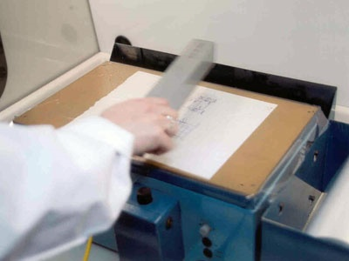
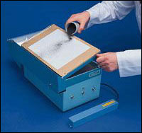
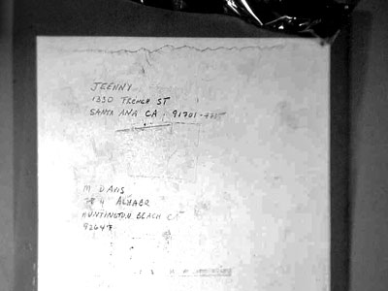
Basic ESDA Steps
Humidify the document (optional)
Place document on metal plate & turn on vacuum
Pull imaging film over document & remove wrinkle
Charge the imaging film with corona wire
Turn off the vacuum and tilt the metal plate
Apply developing powder
Preserve the test results
http://www.postalmuseum.si.edu/inspectors/a6p2.html

Slide 9
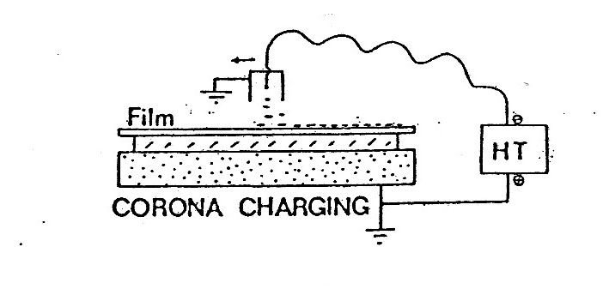
Electrostatic Methods of ESDA (1)
corona wire (inside a metal case)
Corona wire inside the corona unit is charged at a high negative voltage of 5kV.
Subsequently, the negative charges are transferred to the imaging film.
charges transferred
document
platen
Notes:
These wires are subjected to a high voltage, which they subsequently transfer to the drum and paper in the form of static electricity.
HT = Hight Voltage Terminal
Because, currently ESDA do not have voltage probes that measure the degree of charging at the surface of the film.
For most examiners, the only option is consider the time, distance, and speed of moving the corona to charge the film.
Once critical step involves charging the imaging film. The document examiner may hold the corona a certain distance from the film while passing it over the document at a constant speed following a particular path.
Passing the corona wire too close to the imaging film is apt to produce black lines through the developed image that are due to the irregular electrostatic field produced. This “noise” is more noticeable when the corona wire is dirty.
Negative corona is known to generate high amount of ozone. Ozone is not only a health risk but it also damages polymeric materials such as rubber and plastic causing them to deteriorate prematurely.
There are three ways to transfer charges : friction, conduction and induction.
friction - charging something by rubbing it against another object
induction - charging something by coming close to charged object, but not touching
conduction - charging something by touching a charged object

Slide 10
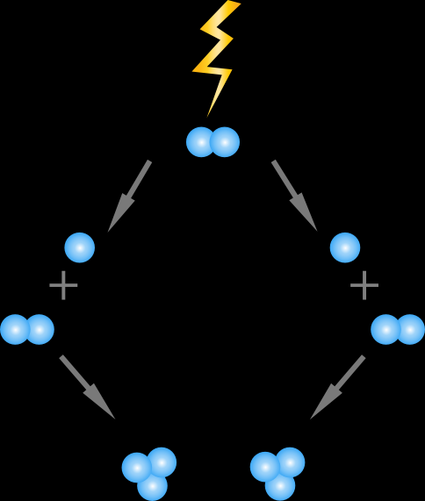
Ozone Generation from ESDA
discharging
When the corona wand is used, the electric filament generates ozone gas.
The ozone gas is generated from the corona discharging.
Ozone can cause respiratory irritation and breathing difficulty.
O₂
O⁻
O⁻
O₃
O₃
http://www.ozoneapplications.com/info/cd_vs_uv.htm
Notes:
Corona Discharge (CD) ozone generation
Air (usually ambient) is passed over an ultraviolet lamp, which splits oxygen (O₂) molecules in the gas. The resulting oxygen atoms (O⁻), seeking stability, attach to other oxygen molecules (O₂), forming ozone (O₃). The ozone is injected into the water, or air stream, where it inactivates contaminants by actually rupturing the organisms’ cell wall.
The technologies involved in corona discharge ozone generation are varied, but all operate fundamentally by passing dried, oxygen-containing gas through an electrical field. The electrical current causes the “split” in the oxygen molecules as described in the section on ultraviolet ozone generation. Past this common feature the variations are many, but the generally accepted technologies can be divided into three types - low frequency (50 to 100 Hz), medium frequency (100 to 1,000 Hz), and high frequency (1,000 + Hz). Since 85% to 95% of the electrical energy supplied to a corona discharge ozone generator produces heat, some method for heat removal is required. Also, proper cooling significantly affects the energy efficiency of the ozone generator, so most corona discharge systems utilize one or more of the following cooling methods: Air or water.

Slide 11
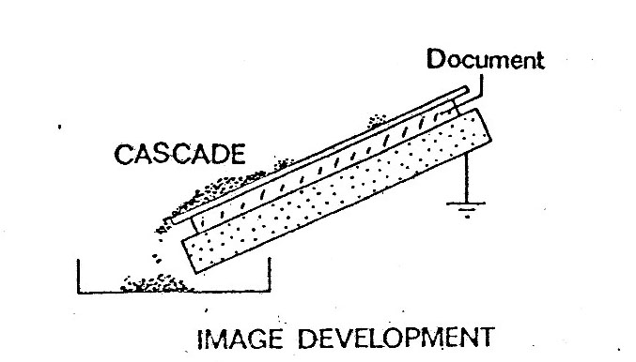
Electrostatic Methods of ESDA (2)
Toner is cascaded across the film while the platen is raised.
Variables include :
  Angle of platen
  Position of paper and platen
  Rate of flow, and
  Amount of toner deposited
Alternatively, a fine powder may be sprayed from a nozzle.
charged pigmented toner powder

Slide 12
Imaging Film
The insulating imaging film has a polyester base manufactured under the trade name Mylar.
The thickness of film is roughly 5 to 10 microns.
Important roles of the film include
  protect the document from the developing powder, and
  act as a dielectric or insulating, charge-trapping material.

Slide 13
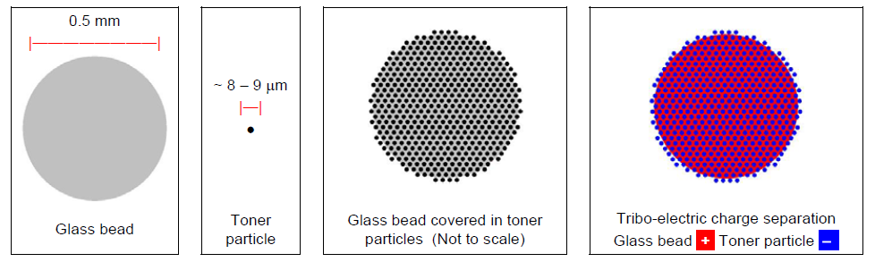
Cascade developer
Cascade developer is a mixture of glass beads and ESDA toner.
The tribo-electric properties of the two materials are carefully selected so that the glass naturally loses electrons to the toner material, causing the beads to charge positively and the toner particles negatively.
The constituents interact and the beads become coated with toner particles.
Notes:
Cascade developer is a mixture of glass beads and ESDA toner. The tribo-electric properties of the two
materials are carefully selected so that the glass naturally loses electrons to the toner material, causing the
beads to charge positively and the toner particles negatively. When combined in the appropriate
proportions, the constituents interact and the beads become coated with toner particles, thereby acquiring
their characteristic grey/black metallic sheen. Cascade developer is supplied in containers from which the
developer is dispensed during the development procedure.

Slide 14
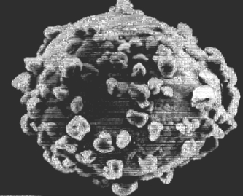
Toner
Toner is a fine, negatively charged, black powder similar to that used in photocopying machines and laser printers.
Toner powder becomes tribo-electronically charged when in contact with glass beads.
A small glass bead coated with particles of toner
http://home.howstuffworks.com/photocopier.htm
Notes:
Tribo electrically การถูวัสดุสองชนิด แล้วทำให้เกิดการถ่ายเทประจุ
The triboelectric effect (also known as triboelectric charging) is a type of contact electrification in which certain materials become electrically charged after they come into contact with another different material and are then separated (such as through rubbing). The polarity and strength of the charges produced differ according to the materials, surface roughness, temperature, strain, and other properties

Slide 15
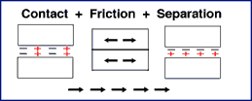
Triboelectric Effect
The triboelectric effect is also known as triboelectric charging.
The process of triboelectric charging results in one object gaining electrons on its surface, and becoming negatively charged, and another object losing electrons from its surface, and becoming positively charged.
http://www.nandee.co.th/newweb/articles/article_static_elec.htm
Notes:
The process of electron transfer as a result of two objects coming into contact with each other and then separating is known as 'triboelectric charging'. The prefix 'tribo' means 'to rub.' The process of triboelectric charging results in one object gaining electrons on its surface, and therefore becoming negatively charged, and another object losing electrons from its surface, and therefore becoming positively charged.

Slide 16
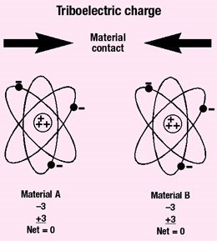
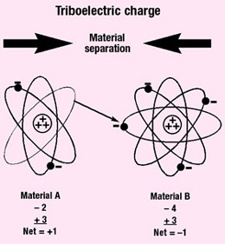
Triboelectric Charging
(1) Before contact, both materials are electrically neutral.
(2) After contact, both materials are differently charged.
http://www.ce-mag.com/99ARG/ESD%20AssIntro169.html
Notes:
When the two materials are placed in contact and then separated, negatively charged electrons are transferred from the surface of one material to the surface of the other material. Which material loses electrons and which gains electrons will depend on the natures of the two materials. The material that loses electrons becomes positively charged, while the material that gains electrons is negatively charged

Slide 17
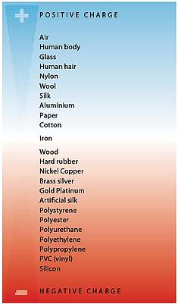
Troboelectric Series
a triboelectric series shows a ranking of materials' ability to hold or give up electrons.
http://www.simco.nl/info/about-simco/introduction-to-static/
Notes:
When humidity is low, higher static charges are generated more easily. Static becomes more noticeable in the winter months, in dry climates, and in air-conditioned environments. Increasing humidity to 60% limits static build-up as surface moisture on materials makes a good conductor. Unfortunately, 60% relative humidity is extremely uncomfortable, can cause equipment problems, and introduce contaminants

Slide 18
Charging Distribution on the Imaging Film
Variations on the surface of the document cause correspondent distribution of toner on the document.
The deeper the indentation, the more toner adheres to the spot.
Images of indentation are developed as black lines on a lighter background.
The image may be recorded photographically or preserved with a protective transparent adhesive covering.
ESDA lift off impression
http://www.postalmuseum.si.edu/inspectors/a6p2.html
Notes:
Both the imaging film and the toner powder are negatively charged.

Slide 19
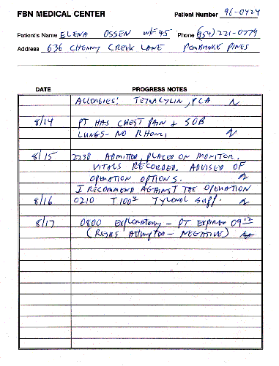
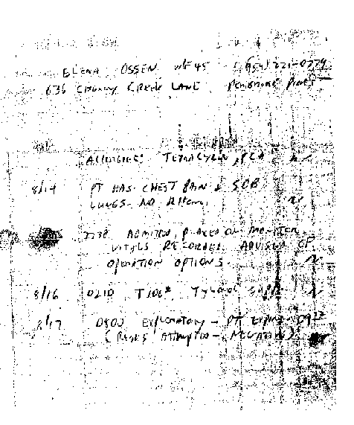
Questioned Document Example
Original questioned medical record suspected of being changed.
ESDA recovered indented writing from the following page in the medical records
Notes:
Fig 1 Original questioned medical record suspected of being changed. The specific area is "I recommend against the operation."
Fig 2 Indented writing (ESDA) recovered from the following page in the medical records displays everything from the previous page except the questioned entry. This would indicate that the questioned entry was written subsequent to the rest of the page (probably after the patient died and the filing of the lawsuit).

Slide 20
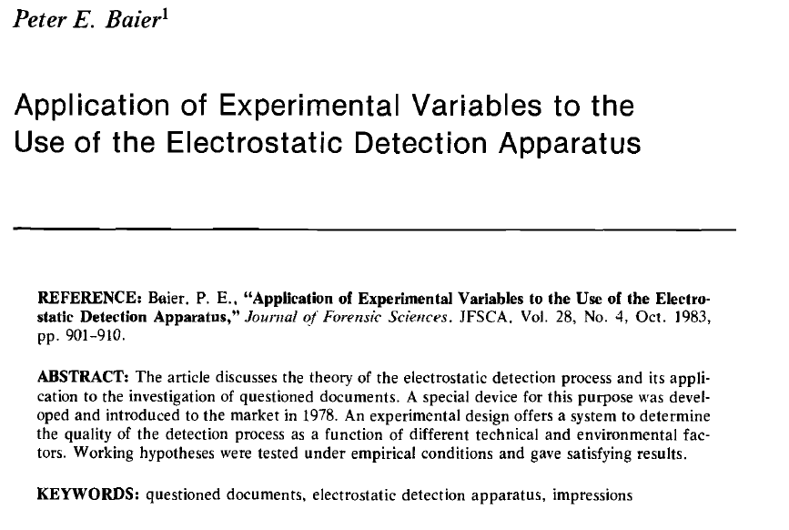
Interesting research on ESDA # 1

Slide 21
Variables affecting the results of ESDA
Interesting research on ESDA # 1
Paper types and quality : poor results from shiny paper, thin newspaper and severely crumpled paper.
Writing instrument : good results from ball point pens
Level of impression : number of layers affecting the quality of the reproduction quality.
Humidity and temperature : humidified documents recommended for better contrast.
Development method : cascade development method is better for weaker indentations.
Flexibility of the polymer films : poor elastic films may not follow the relatively deep grooves of some indented writing.
Notes:
Some of these variables have been considered by previous research.
The quality of the image which can be produced by ESDA is highly dependent on raw materials, chemical treatments, impregnations and surface finishes which are found on different types of papers.
Variables : 1. paper types and quality : paper with shiny surface such as photographic paper, poor quality papers with low units density such as newsprint
Also severely crumpled and ceased paper.
2.Writing instrument : good or poor results from writing instrument depends on the amount of pressure that is required to produced the writing. Good to poor results ::: ball point pen, roller ball pen, mechanical pencil , standard pencil and felt pen.
3. Level of impression ; In general it is acceptable that as the number of layers increases, the indentations present become weaker and the image impressions become paler.
4. Humidity and temperature : Foster and Morantz concluded that there was no indication that humidity had a role to play in the process. However, the ESDA manufactures recommend that documents are humidified for 1 -2 minute in a saturated environment if the relative humidity is below 40%.
5. Charging technique and image development: The creation of a potential difference which allows for any indented writing on a document to be visualized. Experience and practice provide good results. There is no hard and fast rule about the manner of length of time the corona unit should be used to charge the surface of a document as this can be dependent on various factors including the type of document, paper quality, humidity and the operator’s own personal experience.
6. Development method : cascade development method is better for weaker indentations. Old or heavily used beads may take on an appearance of being roughed and pitted on their surface which may reduce the ability of the beads to attract and retain toner particles. This can lead to poor quality image development.

Slide 22
Use caution when operating ESDA
The examiner using ESDA should exercise caution since
extreme voltages are part of the application (≈ 8kV) and
the quantities of ozones produced by the wand are far in excess of the safe exposure rates which should be considered a health hazard.

Slide 23
Summary
The electrostatic detection apparatus (ESDA) is a technique most commonly used for the visualization of indented impression on questions documents.
The function of ESDA is based on the change in the dielectric properties of the paper due to some form of microscopic damaged sustained by the paper fibers during the formation of indented writing.

Slide 24
References
D J Foster and D J Morantz, “An Electrostatic Imaging Technique For The Detection Of Indented Impressions In Documents”, Forensic Science International, 13, 51-54 (1979).
D M Ellen, D J Foster and D J Morantz, “The Use Of Electrostatic Imaging in the Detection Of Indented Impressions”, Forensic Science International, 15, 53-60 (1980).
P E Baier, “Application of experimental variables to the use of the electrostatic detection apparatus”, Journal of Forensic sciences, 28, 901-910 (1983).
N N Daeid, K Hayes and M Allen, “Investigations Into Factors Affecting the cascade developer used in ESDA- A review”, Forensic Science International, 181, 1-9 (2008).

Slide 25
Appendix : Thickness variation theory
Theoretical Explanation (1)
Preliminary consideration
The indented writing is visualized as the change in the dielectric properties of the paper due to some form of microscopic damage sustained by the paper fibers; i.e. indented impressions.
The potential difference on the surface of the imaging film is created by the application of the electric charge through the corona wire.
The metal plate and film constitute a capacitor and the paper document is considered as an insulator (or dielectric) between the two.
Notes:
The visualization of the indentation is based on a change in the dielectric properties of the paper due to some form of microscopic damage sustained by the paper fibers during the formation of indented writing.

Slide 26
Theoretical Explanation (2)
Mechanisms
The capacitive arrangement is a key to describe the electrostatic phenomenon.
At the place where the thickness of the paper decreases (the point of indentation), the dielectric constant of the paper increases and results in a decrease of the surface potential.
This leads to a difference in potential across the paper.
The negatively charged toners, being repelled from the high negatively charged background, adhere preferentially to those lower potential areas which corresponds to the indented writing.
This is assumed that the impressions could be developed because of a reduction in the thickness of the paper.

